Slide 1
Outline
Introduction
Objectives
Functional Requirements and Non Functional Requirements
Use Case
Diagrams (use case , sequence , class and activity diagrams)
Business Opportunities of the Software

Slide 2
Introduction
Njangi is a traditional rotating savings and credit association where members contribute a fixed amount of money regularly, and each member takes turns receiving the total amount. It is a form of community-based financial support.

Slide 3
OBJECTIVES
Implement a user friendly interface with clear navigations, allowing participants to interact with the application without encountering unnecessary complications or confusion.
Implement a participant management system, involving tools or processes to help manage members profile, contributions, payout and financial tracking within the njangi group.
Integrate secure financial transactions ensuring that the monetary contributions, rotations and payouts within the rotating savings and credit association are conducted in a manner that is safe, reliable and transparent for all participants.
Implement suitable communication and notification mechanisms to inform the participants about important announcement, days to play njangi, updates or changes related to the njangi

Slide 4
Functional requirements
User registration and profile management
Njangi group creation
Contribution management
Rotation Schedule
Notifications
Fund distribution
Transaction history
Security

Slide 5
Non functional requirements
Performance
Scalability
Reliability
Usability
Compatibility
Data back up
Security
Support and maintainance

Slide 6
USE CASE
Below are the various actors and their rules:
User: Initiates and participates in Njangi groups. They can create new groups, contribute funds, and receive distributions.
Administrator: Manages the overall system, including user accounts, group configurations, and addressing any system-related issues.
System: Represents the Njangi system itself, coordinating various functions and interactions between users and the database.

Slide 7
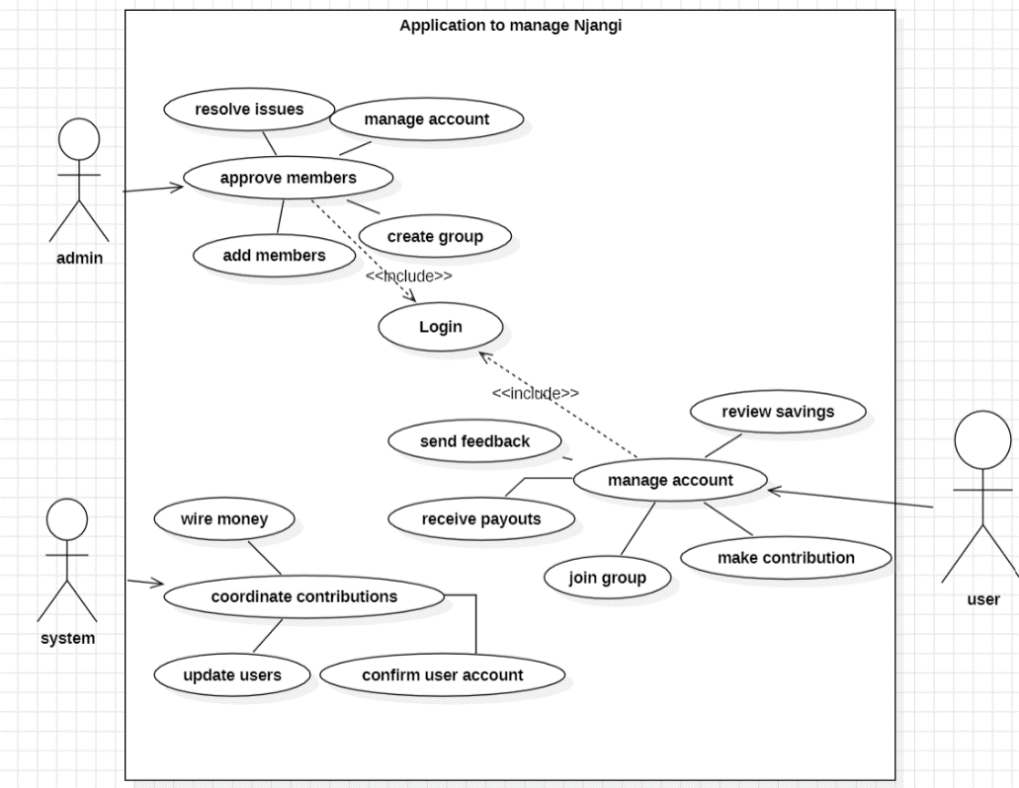
USE CASE DIAGRAM

Slide 8
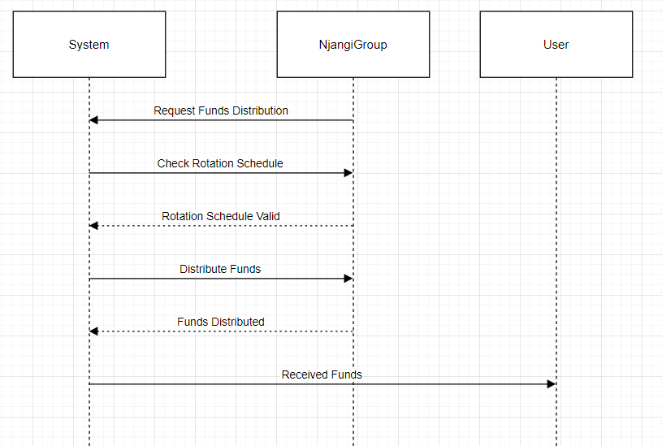
Sequence Diagram Distribute Funds Use Case

Slide 9
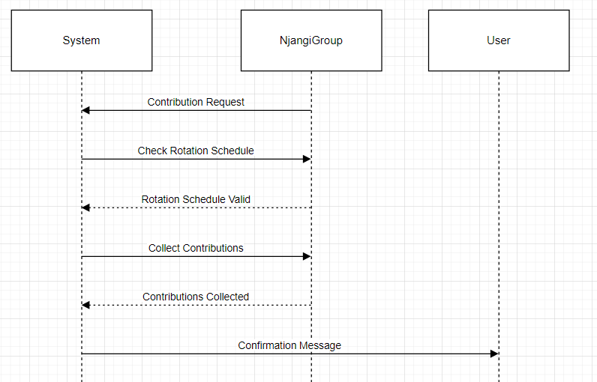
Sequence Diagram Coordinate Contributions Use Case

Slide 10
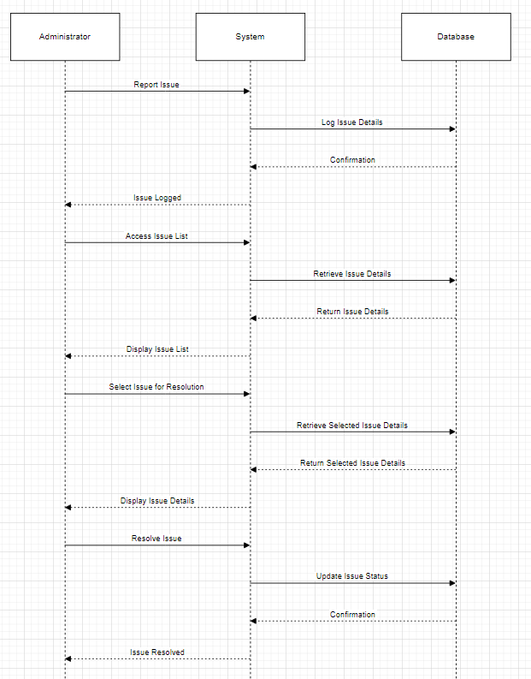
Sequence Diagram Resolve Issues Use Case

Slide 11
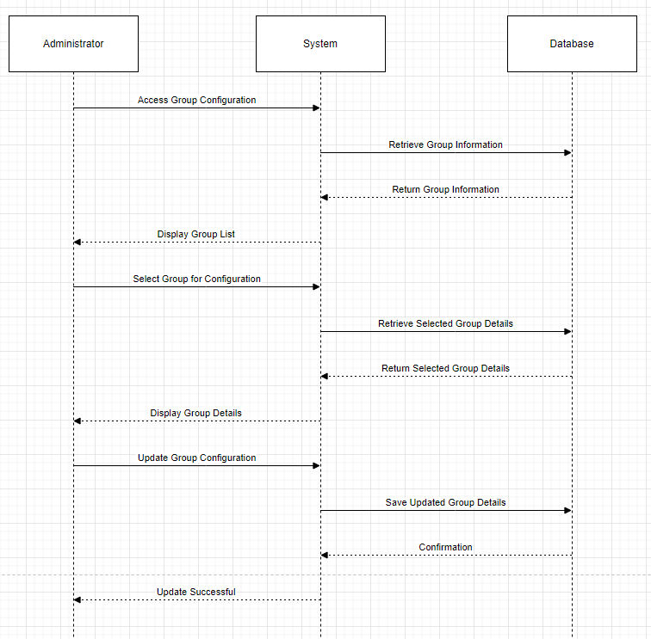
Sequence diagram Configure Njangi Groups use case

Slide 12
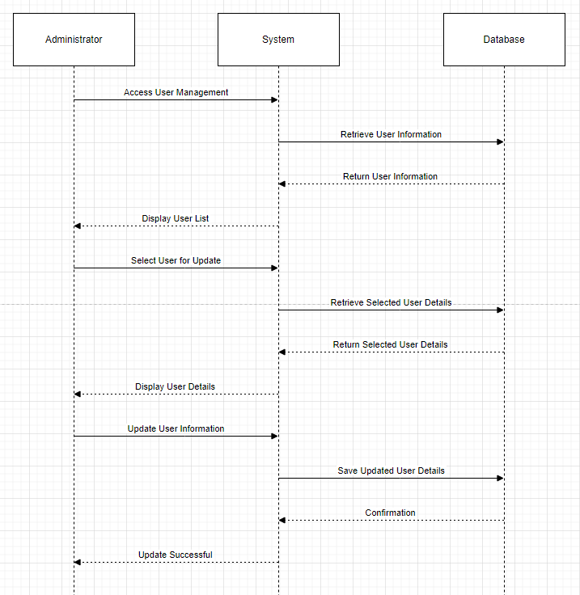
Sequence Diagram Manage User Accounts Use Case

Slide 13
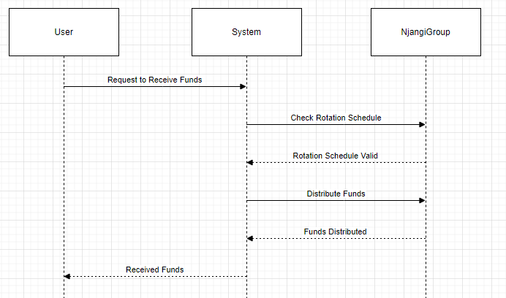
Sequence Diagram Receive Funds Use Case

Slide 14
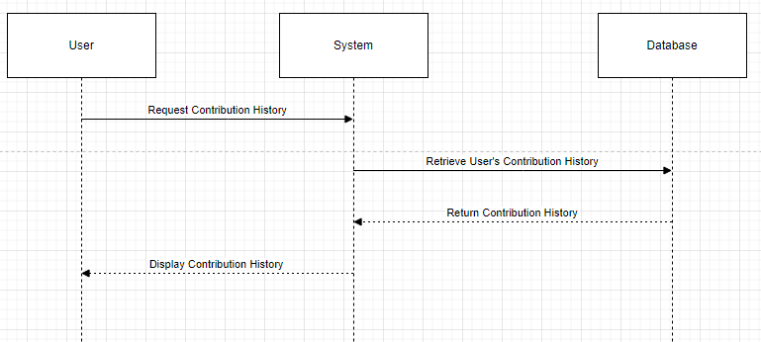
Sequence Diagram View Contribution History Use Case

Slide 15
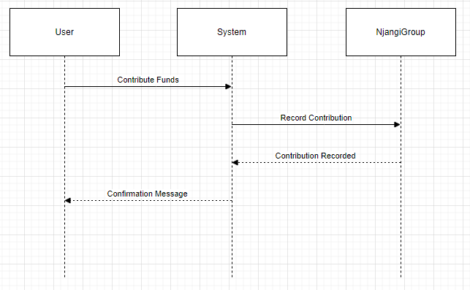
Sequence Diagram Contribute Funds Use Case

Slide 16
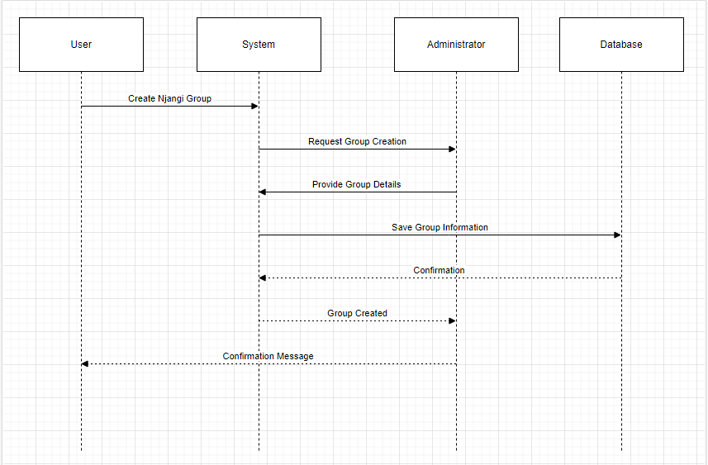
Sequence Diagram Create Njangi Use Case

Slide 17
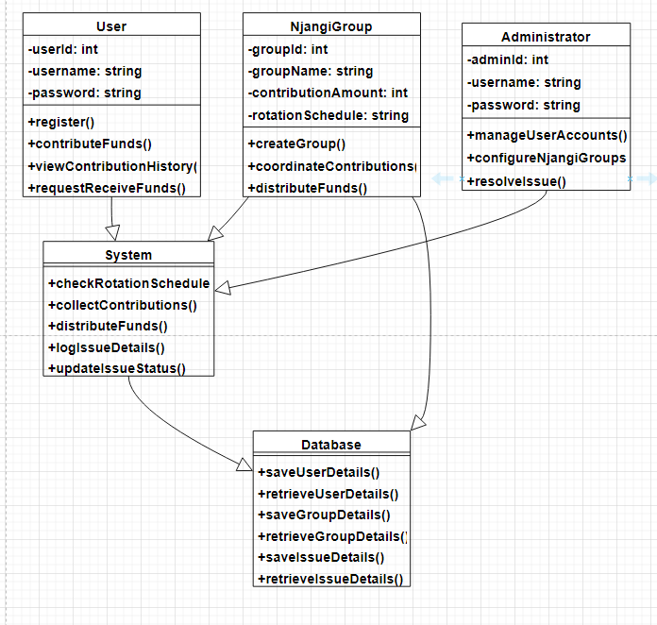
CLASS DIAGRAM

Slide 18
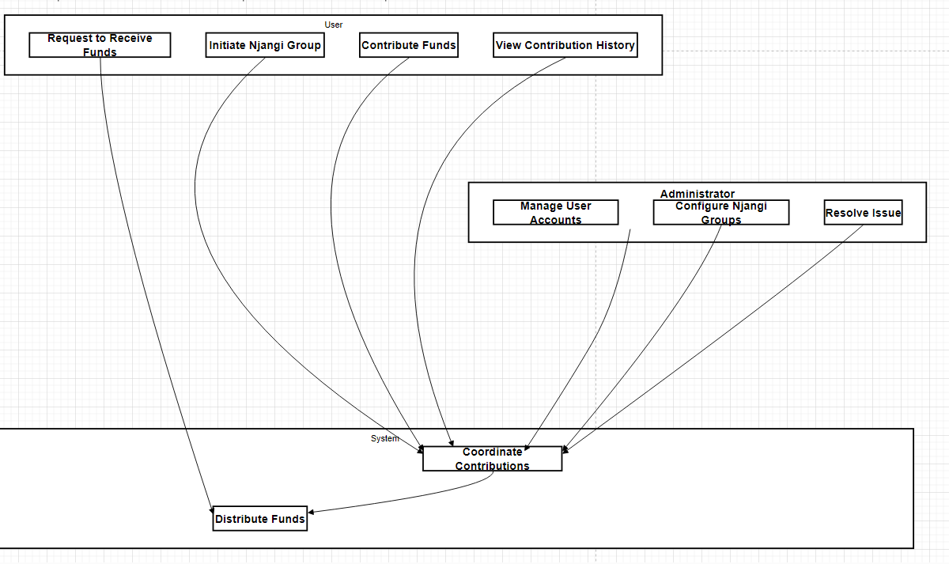
ACTIVITY DIAGRAM

Slide 19
BUSINESS OPPORTUNITIES
Njangi presents various business opportunities. Some potential opportunities include :
Subscription or Licensing Model
Consulting and Customization Services
Educational Services
Mobile Wallet Integration
Data Analytics and Reporting

